Slide 1
Linux Kernel
Lecture 2:
Hardware, CPUs, and a Basic Operating System, Linux Intro

Slide 2
What is an Operating System?
An OS is any and all software that sits between a user program and the hardware
Hardware (e.g., mouse, keyboard)
Operating System
User Program
OS is a resource manager and allocator
Decides between conflicting requests for hardware access
Attempts to be efficient and fair
OS is a control program
Controls execution of user programs
Prevents errors and improper use

Slide 3







GUI
Command Line Shell
Text Editor
Operating System
Hardware (e.g., mouse, keyboard)

Slide 4















Many Different OSes
Windows
Linux
BSD

Slide 5
Goals for Today
By the end of class, we will build a very, very simple command line OS
But to get there, we need to understand the hardware platform we are building on
Basics of PC architecture
How devices and the CPU communicate
What is the basic functionality of the CPU
How do we boot into an OS

Slide 6
Hardware Basics
PC Bootup Sequence
A Simple OS Example
Kernels

Slide 7
Basic Computer Architecture
Architecture determines many properties of the OS
How does the OS load and take control?
How does the OS interacts with devices?
How does the OS manage CPU and memory?
This discussion will focus on the IBM PC architecture
Until recently, most computers could still run MS-DOS based programs from the 80’s and 90’s
Remains the most popular architecture
But not for long…
Alternatives: Amiga, Macintosh, PowerPC, etc.

Slide 8
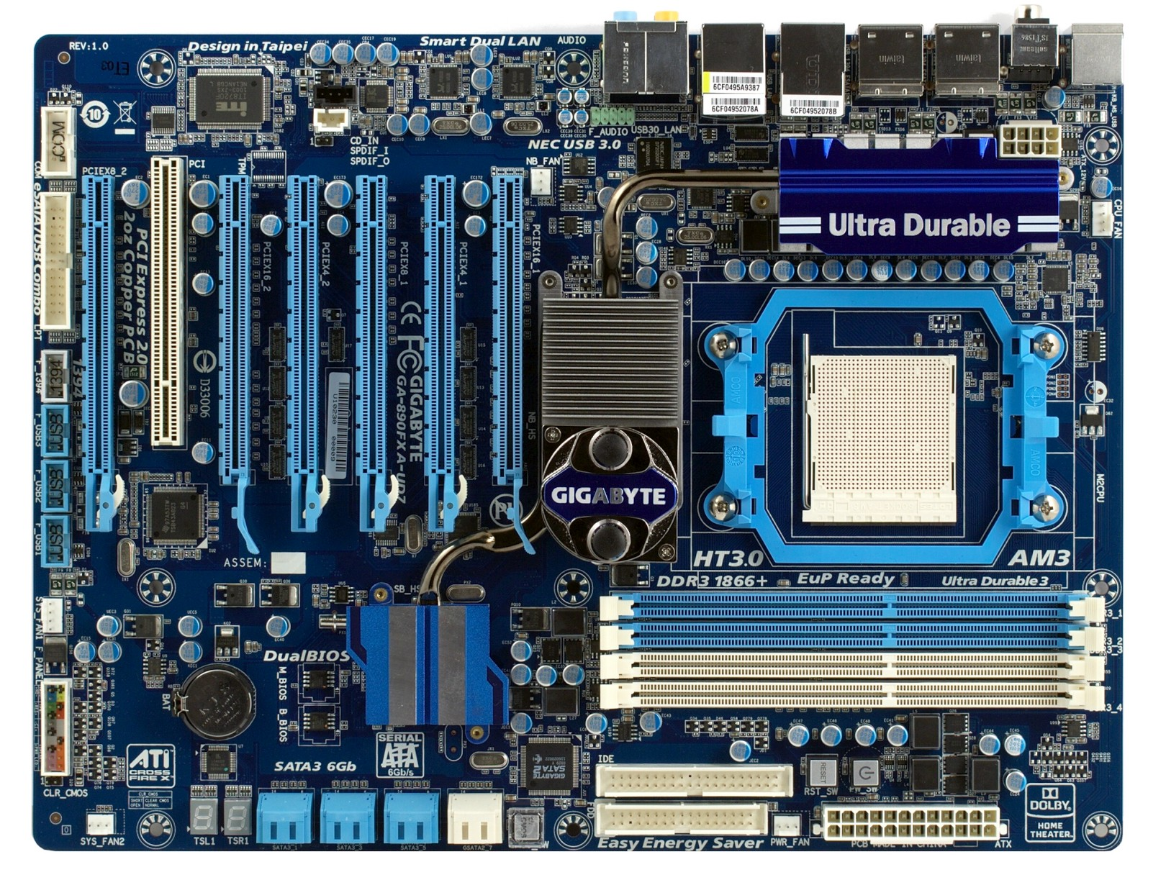
PCI slot
PCI-x16 slots
USB Headers
North Bridge
CPU socket
South Bridge
RAM Slots
SATA Plugs
PATA Connectors

Slide 9
L1, L2, L3 Cache
CPU(s)
All devices compete for access to memory
North/South Bridge
Memory
Graphics
Graphics Memory
…
I/O
I/O
I/O

Slide 10
Basic CPU Layout
Main Memory
System Bus
L1 (and L2, L3) Cache
Instruction Fetch
Floating Point (FPU)
Arithmetic and Logic (ALU)
Arithmetic and Logic (ALU)
Registers
Decode
Control Unit

Slide 11
Registers
Storage built in to the CPU
Can hold values or pointers
Instructions operate directly on registers
Things from memory can be loaded into registers…
… or things in registers can be moved to memory
Some registers have special functions
Pointing to the current instruction in memory
Pointing to the top of the stack
Configuring low-level CPU features
Etc.

Slide 12
Storage Hierarchy
Smaller / Faster
CPU Registers
1KB
CPU L1/L2/L3 Cache
1 - 32MB
Main Memory (RAM)
4 - 256GB
Solid State Drive (SSD)
32 GB – 1 TB
Hard Drive
512 GB – 4 TB
Tape Drive
1 – 8 TB
Larger / Slower

Slide 13
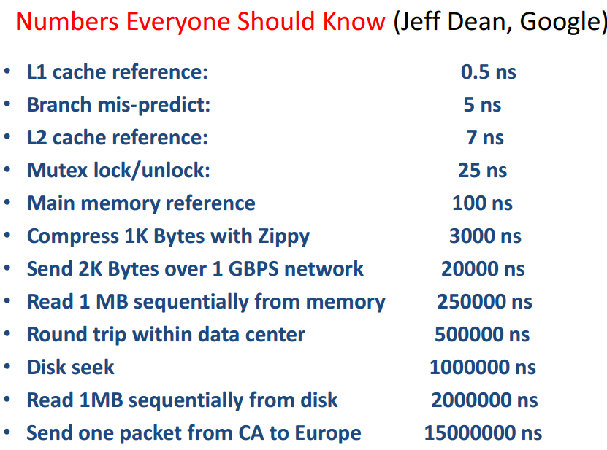
Notes:
2007

Slide 14
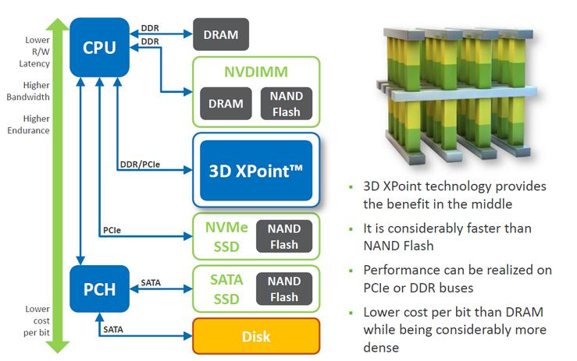
Future Computing Arch: Nonvolatile Memory 10TB 2017

Slide 15
x86 Registers (32 bit)
General purpose registers
EAX, EBX, ECX, EDX
Used for pretty much anything
Stack registers
ESP: Points to the top of the stack
The stack grows down, so this is the lowest address
EBP: Points to the bottom of the current stack frame
Not strictly necessary, may be used as a general purpose register
Other registers
EIP: Points to the currently executing instruction
EFLAGS: Bit vector of flags
Stores things like carry (after addition), equals zero (after a comparison), etc.

Slide 16
Register Layout
x86 has gone through 16, 32, and 64 bit versions
Registers can be addressed in whole or in part
RAX
64 bits
EAX
32 bits
AX
16 bits
AH
AL
8 bit high and low

Slide 17
x86 Assembly Examples
mov eax, 0x00ABCDE ; move 32-bit value to EAX
mov ax, 0xABCD ; move 16-bit value to AX
mov ah, 0xAB
mov al, 0xCD ; 3) + 4) are equivalent to 2)
add eax, ebx ; result stored in EAX
mov edx, [esp] ; dereference the pointer in ESP, move the value to EDX

Slide 18
Important x86 Instructions
In Intel assembly syntax, [] means dereference (e.g. *ptr in C)
Instructions | Description | Examples
mov | Move data from one place to another | mov eax, 7 mov edx, [0xF0FF] mov [ebx], eax
add / sub | Add / subtract values in registers | add eax, ebx
inc / dec | Increment / decrement the value in a register | inc eax
call | Push EIP onto the stack and jump to a function | call 0x80FE4C
ret | Pop the top of the stack into EIP | ret
push / pop | Add or remove items to the stack | push eax
int | Execute the given interrupt handler | int 0x80
jmp | Load the given value into EIP | jmp 0x80FE4C
cmp | Compare the value of two registers and store the value in the flags register | cmp ebx, edx
jxx | Load the given value into EIP if the condition is met | jz 0x80FE4C jnz 0x80FE4C
Basics
Func.
Stack
Control Flow

Slide 19
Typical Memory Layout
Top
0xFFFF
Example: 64KB of memory
2¹⁶ bytes
Addresses from 0 to 65535
Not all memory is free
Specific ranges get used by devices, system services, the BIOS, etc.
Memory mapped devices
0xF000
Free Memory
0x0DFF
BIOS Code
0x00FF
Interrupt Vector
Bottom
0x0000

Slide 20
Memory Addressing
Memory can be addressed as:
Individual bytes
Multi-byte words, double words, quad words, etc.
Address | Value
0xC7 | 0x00
0xC6 | 0x00
0xC5 | 0x10
0xC4 | 0x05
0xC3 | 0x00
0xC2 | ‘c’
0xC1 | ‘b’
0xC0 | ‘a’
mov ax, [0xC4] ; AX = 0x0510
mov ah, [0xC0] ; AH = ‘a’

Slide 21
Communicating with Devices
CPU and devices execute concurrently
How do CPU and devices communicate?
I/O Ports
I/O-only memory space shared by the CPU and a device
Memory mapping
Regions of RAM that are shared by the CPU and a device
Interrupts
Signal from a device to the CPU
Interrupt causes the OS to switch to handler code

Slide 22
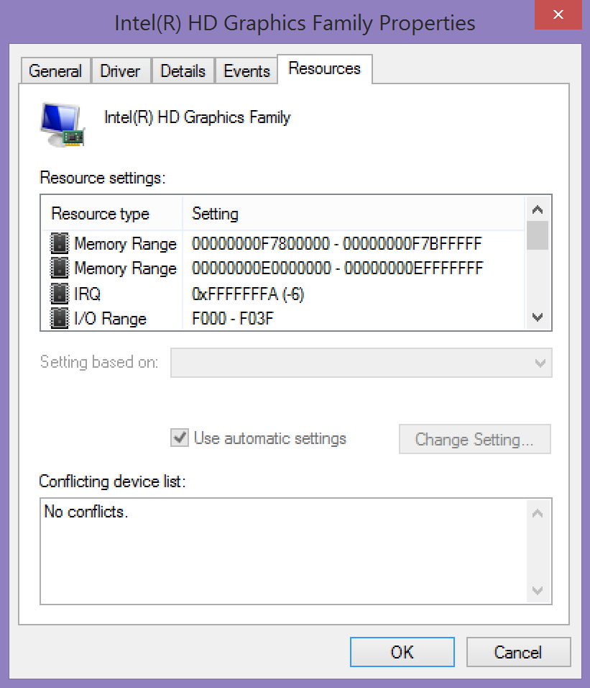
Shared Memory
Interrupt
I/O Ports

Slide 23
I/O Ports
Oldest method of interacting with devices
CPU and devices share a virtual 16-bit memory space
Each device is assigned some portion of the address space
E.g. 0xF000 – 0xF03F
CPU and device communicate by reading/writing to the virtual memory space

Slide 24
I/O Port Example
Assume there is a serial port attached to port 0x3F8
Output
Input
mov eax, 1
mov dx, 0x3F8
start: out dx, al
inc eax
cmp eax, 32
jne start
…
mov ebx, 0
mov dx, 0x3F8
start: in dx, ax
mov [esp + ebx], ax
inc ebx
cmp ebx, 31
jle start
…

Slide 25
Problem With I/O Ports
CPU must mediate all transfers
Suppose you want to move data from disk to memory…
CPU must copy each 16-bit value from the I/O port to memory
All I/O must be synchronous
Suppose the disk wants to send data…
… but the CPU isn’t reading the I/O port with in
Bottom line: I/O ports are slow

Slide 26
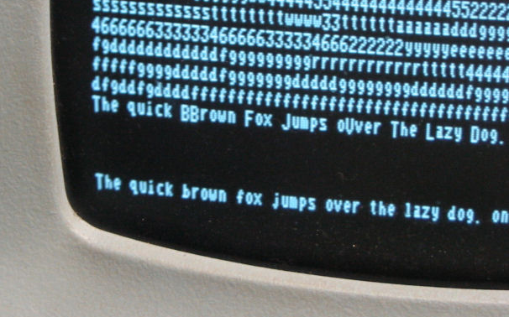
Memory Mapped Devices
RAM shared by the CPU and a device
Example: Console frame buffer
Address range of 1920 bytes
Corresponds to 24 lines of text, 80 characters wide
CPU writes characters into the memory range…
… Video hardware displays them on the screen
Address | Value
0xC2 | ‘e’
0xC1 | ‘h’
0xC0 | ‘T’

Slide 27
Example Keyboard Controller
Simple, memory mapped keyboard interface
2 bytes: keycode byte and status byte
When a key is pressed:
The keycode byte is set to the character
The status byte is set to 1
When the key is read:
CPU sets the status byte to 0
Address | Purpose
0xF801 | keycode
0xF800 | status

Slide 28
Direct Memory Access (DMA)
Enables devices to transfer blocks of data directly to memory
Interrupt generated when transfer is completed
Much faster than the alternative method
Interrupt generated after each byte is transferred

Slide 29
DMA in Action
CPU(s)
Memory
(Instructions and Data)
Instructions
Data
Data via
I/O Ports
Interrupts
Device
Data via DMA

Slide 30
Interrupts
Interrupts transfer control from the running code to an interrupt handler
Each interrupt is assigned a number
Number acts as an index into the Interrupt Vector Table
Table maps interrupt numbers to handlers
Interrupts cause a context switch
State of the CPU must be saved before the switch…
… and restored after the handler completes
Main Memory
0xFFFF
0x01 Handler
0xA146
0x00FF
Interrupt Number | Pointer to Handler
0x02 | 0x0000
0x01 | 0xA146
Interrupt Vector
0x0000

Slide 31
Interrupt Timeline
file.read();
Context Switch
file.read();
User Process
CPU
Interrupts are an example of asynchronous messaging
Interrupts enable the CPU and devices to work in parallel
Interrupt Handler
Idle
I/O Device
Transferring
Time
Read done, raise interrupt
Read done, raise interrupt

Slide 32
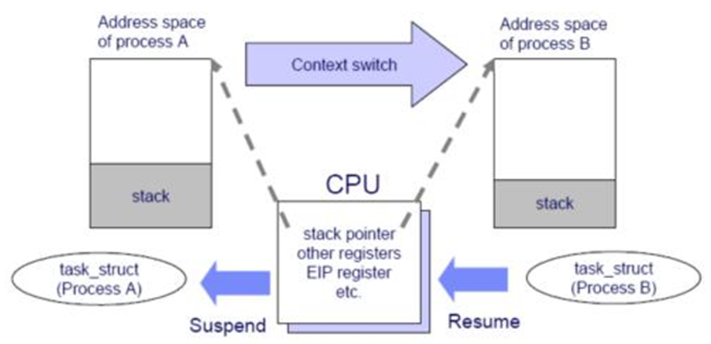
Context Switch on CPU

Slide 33
Hardware Basics
PC Bootup Sequence
A Simple OS Example
Kernels

Slide 34

What Happens After You Push Power?
A lot happens in between
Pushing power…
… And arriving at the desktop
Basic steps
Start the BIOS
Load settings from CMOS
Initializing devices
Run POST
Initiate the bootstrap sequence

Slide 35
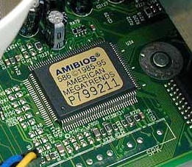
Starting the BIOS
Basic Input/Output System (BIOS)
A mini-OS burned onto a chip
Begins executing a soon as a PC powers on
Code from the BIOS chip gets copied to RAM at a low address (e.g. 0xFF)
jmp 0xFF (16 bits) written to RAM at 0xFFFF0 (2²⁰-16)
x86 CPUs always start with 0xFFFF0 in the EIP register
Essential goals of the BIOS
Check hardware to make sure its functional
Install simple, low-level device drivers
Scan storage media for a Master Boot Record (MBR)
Load the boot record into RAM
Tells the CPU to execute the loaded code

Slide 36
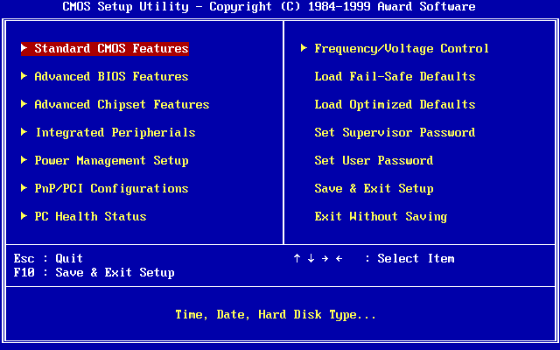
Loading Settings from CMOS
BIOS often has configurable options
Values stored in battery-backed CMOS memory

Slide 37
Initialize Devices
Scans and initializes hardware
CPU and memory
Keyboard and mouse
Video
Bootable storage devices
Installs interrupt handlers in memory
Builds the Interrupt Vector Table
Runs additional BIOSes on expansion cards
Video cards and SCSI cards often have their own BIOS
Runs POST test
Check RAM by read/write to each address

Slide 38
Bootstrapping
Problem: we need to find and load a real OS
BIOS identifies all potentially bootable devices
Tries to locate Master Boot Record (MBR) on each device
Order in which devices are tried is configurable
MBR has code that can load the actual OS
Code is known as a bootloader
Example bootable devices:
Hard drive, SSD, floppy disk, CD/DVD/Bluray, USB flash drive, network interface card

Slide 39
The Master Boot Record (MBR)
Special 512 byte file written to sector 0 (address 0) of a storage device
Contains
446 bytes of executable code
Entries for 4 partitions (DPT)
Address |  | Description | Size (Bytes)
Hex | Dec.
0x000 | 0 | Bootstrap code area | 446
0x1BE | 446 | Partition Entry #1 | 16
0x1CE | 462 | Partition Entry #2 | 16
0x1DE | 478 | Partition Entry #3 | 16
0x1EE | 494 | Partition Entry #4 | 16
0x1FE | 510 | Magic Number | 2
 |  | Total: | 512
Too small to hold an entire OS
Starts a sequence of chain-loading

Slide 40
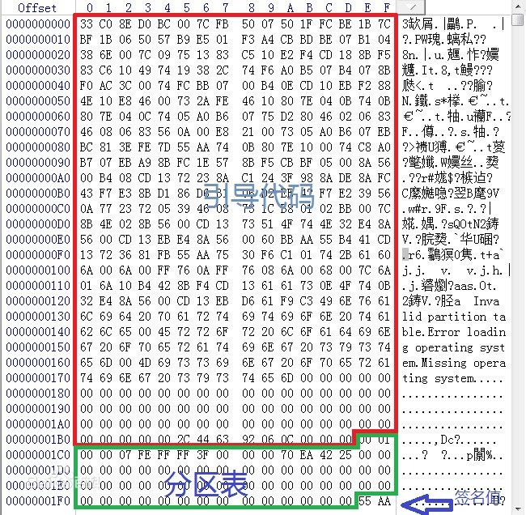
MBR

Slide 41
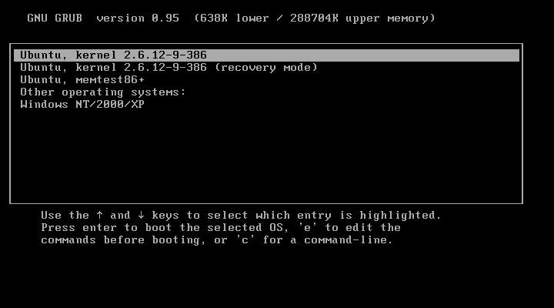
Example Bootloader: GRUB
Grand Unified Bootloader
Used with Unix, Linux, Solaris, etc.

Slide 42
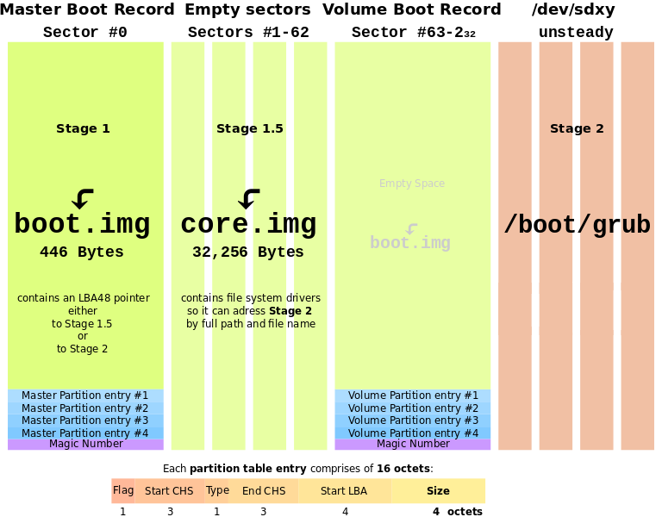

Slide 43
Hardware Basics
PC Bootup Sequence
A Simple OS Example
Kernels

Slide 44

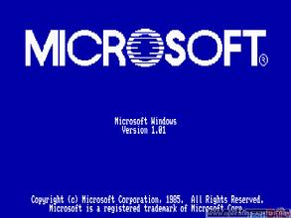
How did Bill Gates code Dos in garage ?

Slide 45
Goals of Our Simple OS
APIs for device access
Read from the keyboard
Read and write to a simple disk
Display text to the screen
Ability to run a simple user program
A basic command line for running programs

Slide 46
Sample Program 1 – Hello World
Writes “Hello World” to the frame buffer
Then loops forever
H
He
Hel
Hell
Hello
Hello W
Hello Wo
Hello Wor
Hello Worl
Hello World
fbuf = 0xF000
str: 'Hello World'
begin: mov eax, str
mov ebx, 11
mov ecx, 0xF000
loop: mov edx, byte [eax]
inc eax
mov [ecx], byte edx
inc ecx
sub ebx, 1
jnz_loop done: jmp done
H
e
l
o
W
o
r
l
d
EDX
0xF000
ECX
0xF001
0xF001
0xF002
0xF003
0xF004
0xF005
0xF006
0xF007
0xF008
0xF009
0xF00A
0xF00B
11
10
9
8
7
6
5
4
3
2
1
0
EBX
EAX
H
e
l
l
o
W
o
r
l
d

Slide 47
Sample Program 1 – Hello World
In this program, there is no OS
Program interacts directly with hardware
This approach might be used for highly-constrained, low-cost environments
Example: simple embedded devices
In a system like this, the program is usually written into read-only-memory (ROM) at the factory

Slide 48
Sample Program 2 – Keyboard to Screen
Reads input from the keyboard and writes it to the frame buffer
framebuf = 0xF000
status = 0xF800
keycode = 0xF801
begin: mov eax, 0xF000
loop: mov ebx, byte [0xF800]
cmp ebx, 0
jz loop
mov ebx, byte [0xF801]
mov [eax], byte ebx
inc eax
mov [0xF800], 0
jmp loop
How can we turn this functionality into an API?

Slide 49
The x86 Stack
Memory
x86 CPU uses ESP register to implement a push down stack
Examples:
push 0x01
pop eax ; EAX = 1
ESP
0xCAFE | 0xAE
0x01 | 0xAA
 | 0xA6
 | 0xA2
 | 0x9E
 | 0x9A
 | 0x96
 | 0x92
 | 0x8E
 | 0x8A
 | 0x86

Slide 50
Function Calls and the Stack
The stack is used to implement function calls
call addr: call a function
Calculates a return address (the address of the instruction following call)
Pushes the return address on to the stack
Jumps to addr (EIP = addr)
ret: return from a function
Pops the return address from the stack
Jumps to the return address

Slide 51
Function Call Example
Suppose we have code that calls
i = add(1, 2);
…
10. push 2
11. push 1
12. call add
13. mov ecx, eax
…
20. add: mov eax, [esp + 4]
21. mov ebx, [esp + 8]
22. add eax, ebx
23. ret
EIP
Memory
ESP
0xCAFE | 0xAE
0x02 | 0xAA
0x01 | 0xA6
13 | 0xA2
 | 0x9E

Slide 52
Argument Ordering and Return Values
Function arguments are always pushed in reverse order
Why?
To support functions with a variable number of arguments
Example: printf(“%i %f %s”, a, pi, str);
Argument 1 tells you how many more arguments there are on the stack
By convention, return values are always placed in EAX
This is why (typical) functions may only return one value

Slide 53
Pop Quiz
What does the stack look like after calling f(7, 10)?
…
27. call f
…
59. f: mov eax, [esp + 4]
…
Memory
10 | 0xAE
7 | 0xAA
28 | 0xA6
 | 0xA2
 | 0x9E

Slide 54
A Minimal Operating System
We’ll now write a simple OS that can:
Read keyboard input
Write it to the frame buffer
getkey()
Loops until a key has been pressed
Loads the key into EAX
getkey: mov edx, byte [status]
cmp edx, 0
jz getkey
mov [status], 0
mov eax, byte [keycode]
ret

Slide 55
putchar()
putchar()
Writes the 2 byte function argument to the frame buffer
Maintains the frame buffer cursor
bufptr: variable holding a pointer to the frame buffer
putchar: mov eax, word [esp+ 4] mov ebx, dword [bufptr] mov [ebx], word eax add ebx, 1 mov [bufptr], ebx ret

Slide 56
Using getkey() and putchar()
We can now rewrite Sample Program 2 using our simple OS
Old Code
New Code
framebuf = 0xF000
status = 0xF800
keycode = 0xF801
begin: mov eax, 0xF000
loop: mov ebx, byte [0xF800]
cmp ebx, 0
jz loop
mov ebx, byte [0xF801]
mov [eax], byte ebx
inc eax
jmp loop
loop: call getkey push eax call putchar pop eax jmp loop

Slide 57
Why Do We Care?
Reusability
Many programs can use getchar() and putchar()
Abstraction
Programs don’t need to know details of the keyboard and frame buffer interfaces
Portability
Program could run on another OS that supports getchar() and putchar()…
… even if the hardware interface has changes

Slide 58
Let’s Build a Basic Shell
Almost all OSes include a shell
A program that takes commands from the user
Earliest (and best) shells were command lines
Modern shells are GUIs
Let’s build a shell into our OS
Read a command line from the keyboard
Read the associated program from the disk
Load the program into memory and execute it

Slide 59
Basic Program Loading
Memory regions are reserved
Memory mapped hardware
OS code
IVT
Etc…
To load and run a program:
Read the program from disk into the program region of memory
Use call to jump to the first instruction of the program
Called the entry point
Main Memory
0xFFFF
Hardware
OS Code
getchar()
putchar()
User Program Region
IVT
0x0000

Slide 60
Example Disk Controller
Disk drive interface
Reads and writes occur in 512-byte blocks
Block numbers start at 0
To write to block B
Copy the data into range 0xF900 – 0xFAFF
Write B to 0xF822
Write ‘W’ to 0xF820
Tells the drive to write the buffer
Drive will write 0 to 0xF820 when the transfer is complete
Address | Purpose
0xFAFF | 512-byte buffer
…
0xF900
0xF822 | block address
0xF820 | cmd/status

Slide 61
Example Disk Controller (cont.)
To read from block B
Write B to 0xF822
Write ‘R’ to 0xF820
Tells the drive to read data from the disk into the buffer
Drive will write 0 to 0xF820 when the transfer is complete
Data from B is now available in 0xF900 – 0xFAFF
Address | Purpose
0xFAFF | 512-byte buffer
…
0xF900
0xF822 | block address
0xF820 | cmd/status

Slide 62
Additional OS APIs
Assume we have already implemented some functions
read_disk_block() reads a block from the disk to some address in memory
getline() reads a line from the keyboard and stores it into a buffer

Slide 63
Basic File System
Assume the disk is divided into blocks
We introduce a trivial file system
Block 0 is the directory mapping of the file system
Other blocks are program data blocks
Block 0 (directory)
Valid? | Name | Addr | len
1 | “file1.txt” | 1 | 2
0
1 | “program.com” | 3 | 3
Blocks 1 and 2
file1.txt
Blocks 3, 4 and 5
program.com

Slide 64
File System Structures
Block 0 (directory)
Valid? | Name | Addr | len
1 | “file1.txt” | 1 | 2
0
1 | “program.com” | 3 | 3
struct dirent {
bool valid;
char name[16]; int start; int len;
};
struct dirent directory[BLK_SIZ/sizeof(struct dirent)]
read_disk_block(/*blk #*/ 0, /*destination*/ directory);
Blocks 1 and 2
file1.txt
Blocks 3, 4 and 5
program.com

Slide 65
Basic Command Line
We can now write a very simple command line:
char buffer[80]; struct dirent directory[NDIR];
int i, start, count;
void *program_base = …; /* probably 0x100 or so */
while (1) {
getline(buffer);
read_disk_block(DIR_SECTOR, directory);
for (i = 0; i < NDIR; i++) {
if (strcmp(buffer,directory[i].name)== 0 && directory[i].valid) {
for (j = 0; j < directory[i].len; j++)
read_disk_block(/* block # */ directory[i].start + j, /* destination*/ program_base + j * 512);
break;
}
}
asm(“call program_base”);
/* returns here when program is done */
}

Slide 66
Limitations of Our OS
Main Memory
Crashes if it can’t find the specified program
If the program crashes, the whole OS needs to be restarted
Programs may not run if the OS is upgraded
Why?
Programs access OS APIs directly
What if the addresses change?
0xFFFF
Hardware
OS Code
getchar()
putchar()
User Program
IVT
0x0000

Slide 67
System Call Interface
System call table
Layer of indirection to abstract the OS APIs
Table is always located at a fixed position
Each OS API is given a specific index in the table
Programs access APIs via the table, instead of hard coding the function address

Slide 68
Traps: Software Interrupts
Software can also generate interrupts
Traps and exceptions are software interrupts
Example:
mov eax, 1 ; system call number goes in EAX, exit() = 1
xor ebx, ebx ; exit() takes one parameter
int 0x80 ; transfer control to the Linux kernel

Slide 69
(Simplified) System Call Example
Software executes int 0x80, pushes EIP
CPU looks up handler in the IVT
CPU transfers control to the OS handler
Handler looks up EAX in the syscall table
Jump to the API code
Main Memory
0xFFFF
OS Code
0xC0F4
printf()
EAX | Pointer to API
1 | 0xC0F4
0xA146
0x80 Handler
Syscall Table
EIP
mov eax, 1
xor ebx, ebx
int 0x80
User Program
Interrupt Number | Pointer to Handler
0x80 | 0xA146
IVT
0x0000

Slide 70
CPU Support for System Calls
Many CPUs provide instruction support for invoking system calls
On x86, system calls are initiated via an interrupt
Example: Linux system calls
On x86, int 0x80 is the system call interrupt
EAX holds the table index of the desired API
EAX | Function
1 | sys_exit
2 | sys_fork
3 | sys_read
4 | sys_write

Slide 71
Our OS So Far
Almost at the level of MS-DOS 1.0
Current features:
Interface to frame buffer
Interface to keyboard controller
Interface to disk controller
Command line
Ability to load and execute simple programs
Uses interrupts to make system calls

Slide 72
Similarities with MS-DOS 1.0
Main Memory
Separate OS and program spaces
System call table accessed via interrupt
Command line is part of OS
Similar keyboard controller, frame buffer, and disk controller
Top
User Program Region
MS-DOS
BIOS
IVT
0x0000

Slide 73
Hardware Basics
PC Bootup Sequence
A Simple OS Example
Kernels

Slide 74
Towards a Kernel
“The one program running at all times on the computer” is the kernel
Typically loaded by the bootloader
Questions:
What are the features that kernels should implement?
How should we architect the kernel to support these features?

Slide 75
Kernel Features
Device management
Required: CPU and memory
Optional: disks, keyboards, mice, video, etc.
Loading and executing programs
System calls and APIs
Protection and fault tolerance
E.g. a program crash shouldn’t crash the computer
Security
E.g. only authorized users should be able to login

Slide 76
Architecting Kernels
Three basic approaches
Monolithic kernels
All functionality is compiled together
All code runs in privileged kernel-space
Microkernels
Only essential functionality is compiled into the kernel
All other functionality runs in unprivileged user space
Hybrid kernels
Most functionality is compiled into the kernel
Some functions are loaded dynamically
Typically, all functionality runs in kernel-space

Slide 77
Monolithic Kernel
Kernel Space
User Space
Monolithic Kernel Code
CPU Scheduling
Program Loader
Memory Manager
User Program
Error Handling
System APIs
Security Policies
File Systems
Device Drivers

Slide 78
Hybrid Kernel
Kernel Space
User Space
Kernel Code
Third-Party Code
Memory Manager
CPU Scheduling
Device Driver
Security Policies
Error Handling
Device Driver
File Systems
System APIs
File System
Program Loader
User Program

Slide 79
Microkernel
Kernel Space
User Space
File System
Disk Driver
Kernel Code
Memory Manager
Networking Service
Network Card Driver
CPU Scheduling
User Program 1
Interprocess Communication
User Program 2

Slide 80



Research Kernels:
Mach
L4
GNU Hurd
Kernels for Embedded System:
QNX
Microkernels:
Small code base,
Few features
Hybrid Kernels:
Pretty large code base,
Some features delegated
Monolithic Kernels:
Huge code base,
Many features

Slide 81
Pros/Cons of Monolithic Kernels
Advantages
Single code base eases kernel development
Robust APIs for application developers
No need to find separate device drivers
Fast performance due to tight coupling
Disadvantages
Large code base, hard to check for correctness
Bugs crash the entire kernel (and thus, the machine)

Slide 82
Pros/Cons of Microkernels
Advantages
Small code base, easy to check for correctness
Excellent for high-security systems
Extremely modular and configurable
Choose only the pieces you need for embedded systems
Easy to add new functionality (e.g. a new file system)
Services may crash, but the system will remain stable
Disadvantages
Performance is slower: many context switches
No stable APIs, more difficult to write applications

Slide 83
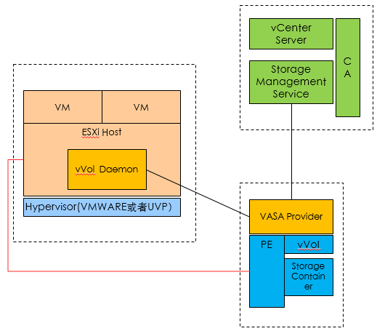
Huawei OceanStore 9000

Slide 84
Huawei OceanStore 9000
Kernel ?
User space ?

Slide 85
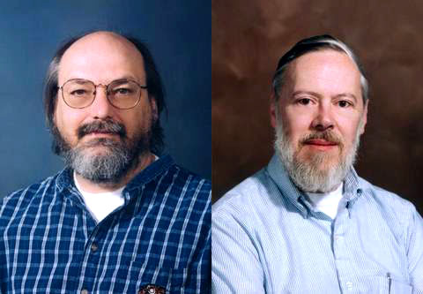
the Inventors of C Language & Unix:
Ken Thompson
（1943 - ）
Dennis M. Ritchie
（1941-2011）

Slide 86
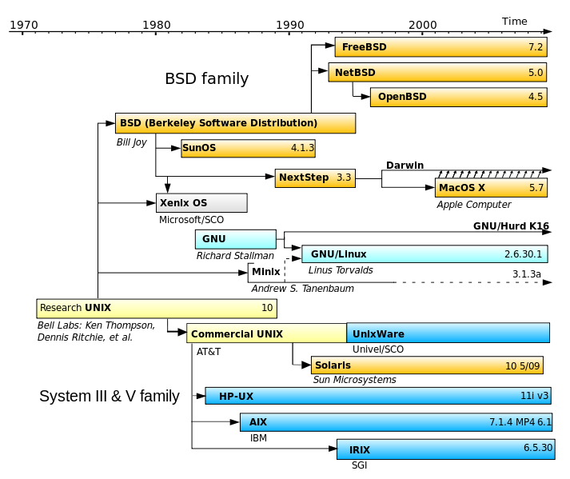
Linux History

Slide 87
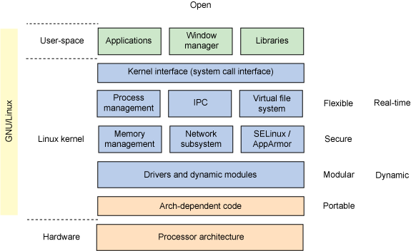
Linux Structure

Slide 88
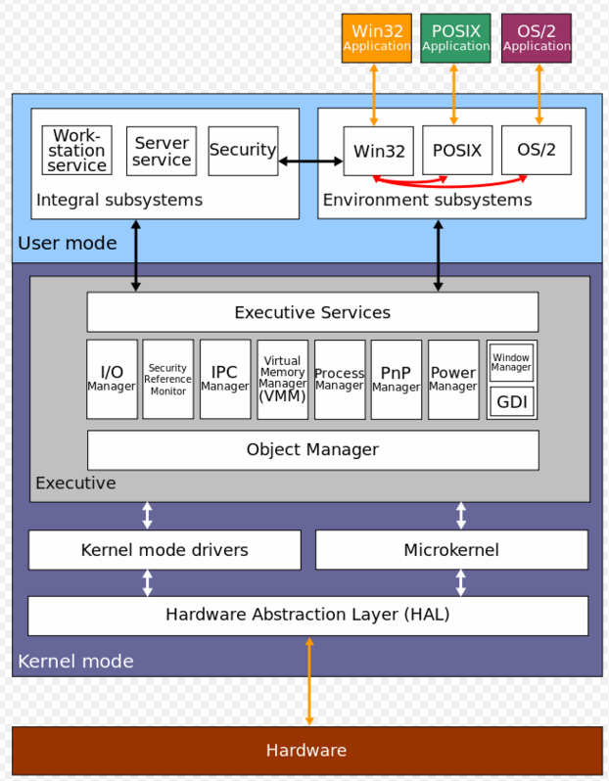
Windows Kernel Structure

Slide 89
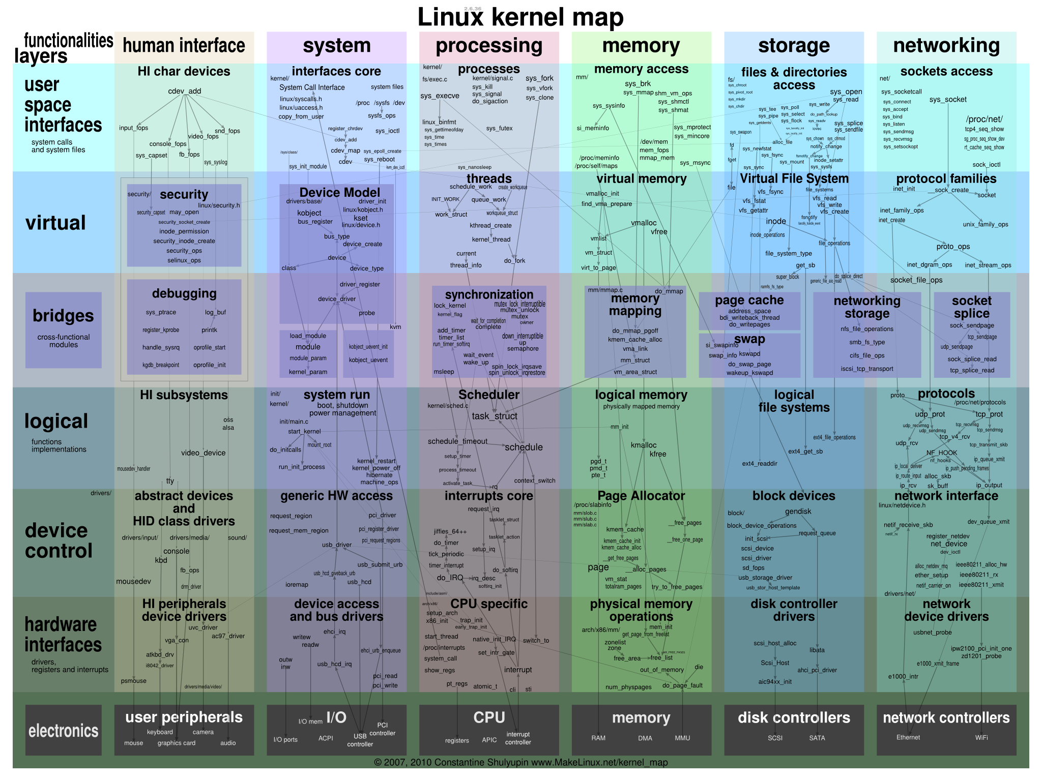

Slide 90
Linux Kernel Design Principle
Simple
Only one or two levels of code
Layered
Lower levels independent of upper levels
Modular
Core kernel with Dynamically loadable modules

Slide 91
Linux Kernel Design Principle
Policy vs. Mechanism
Policy: What do you want to do?
Mechanism: How are you going to do it?
Should be separated, since both change
Algorithms used
Linear, Tree-based, Log Structured, etc…
Event models used
threads vs event loops
System generation/configuration
How to make generic OS fit on specific hardware

Slide 92
Why the Kernel Is Special
Debugging the kernel is usually harder than debugging userland programs.
Errors in user applications lead to a segmentation fault or a core dump, but kernel errors will take the whole system down.
It must be taken into account that many architectures on which the kernel runs do not support unaligned memory access without further ado.
Linux kernel code must be both reentrant and thread-safe.
Must work both on machines with little and big bendiness.
Most architectures do not allow performing floating-point calculations in the kernel

Slide 93
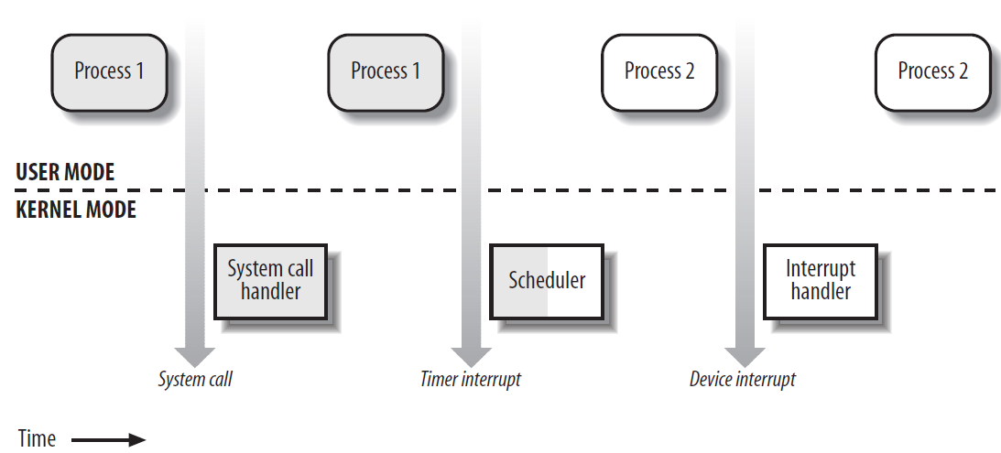
Transitions between User and Kernel Mode

Slide 94
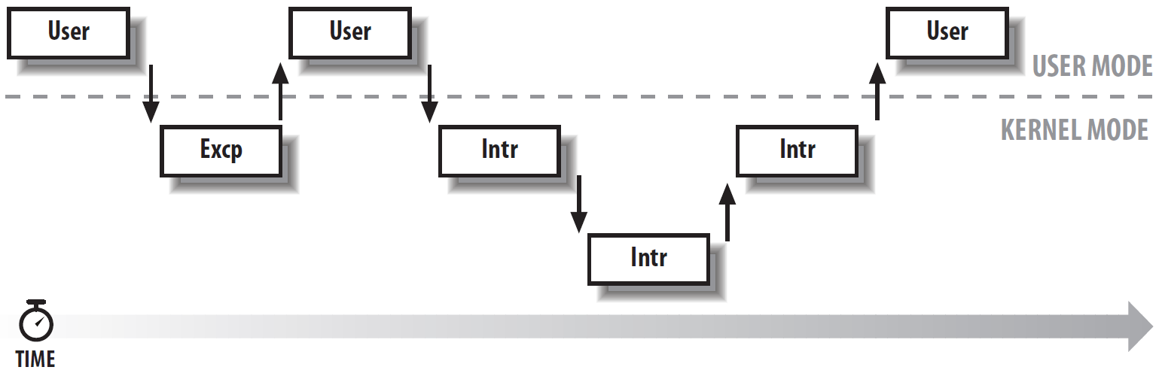
kernel reentrant Interleaving of kernel control paths
A process executing in User Mode invokes a system call
The CPU detects an exception—for example, access to a page not present in RAM
A hardware interrupt occurs while the CPU is running a kernel control path with the interrupts enabled
An interrupt occurs while the CPU is running with kernel preemption enabled

